Slide 1


FabLab San Diego Raspberry Pi
Learning the Basics

Slide 2
Overview
Class 0 | Learning the Basics
Class 1 | Introduction to Raspberry Pi Learning Linux
Class 2 | Using Python to program Input/Outputs

Slide 3
Learning Objectives
Know electronic fundamentals
Electricity, Analog, DC
Current, Voltage, Resistance
Ohms law
Circuits, Schematics
Breadboards, Wires, Resistors, LEDs
And much more!
Know basic Linux terminology
Know basic coding logic

Slide 4
Electricity
A form of energy resulting from the existence of charged particles
What is electricity in English?
Static
Direct Current
Alternating Current

Slide 5
Static Electricity
http://www.youtube.com/watch?v=wm8zJNxmqgo

Slide 6
Alternating and Direct Current
Where can we find it in a home?
What uses it?
http://www.youtube.com/watch?v=iDH-RiDxqE4&noredirect=1

Slide 7
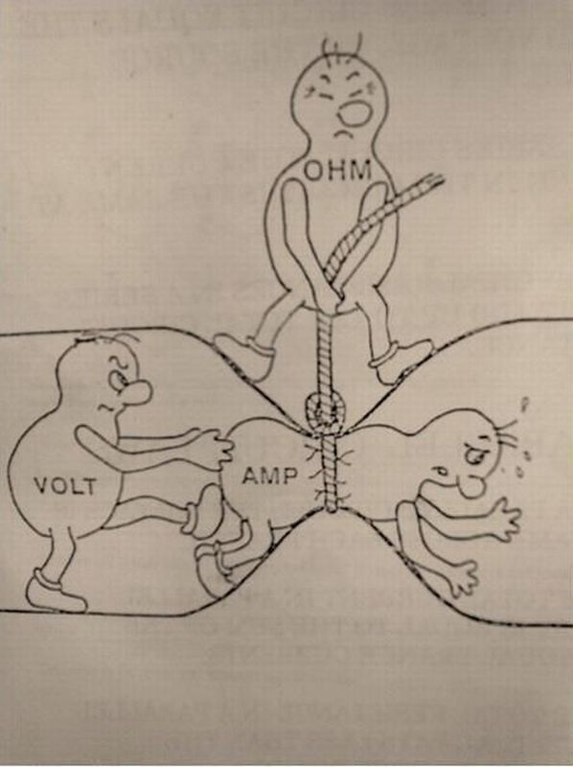
Follow the Law!
Voltage ( V ) VOLT
Current ( I ) AMP
Resistance ( R ) OHM
LAW: V = I x R

Slide 8
Math
Math is your friend
Examples:
I = 2 mA
R = 100 Ω
Remember V = I x R
V = 2 V
V = 5 V
R = 5000 Ω
I = 1A

Slide 9

Power

Slide 10
Power
What is power?
Expressed in Watts
Power = V x I
Power = Force x velocity
How much power does a 60 watt light bulb use?
Power costs money
What’s another form of power?
Knowledge

Slide 11
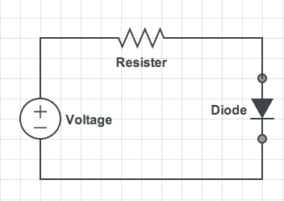
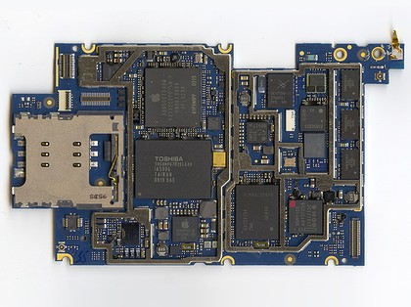

Circuits
Simple schematic
Complicated Circuits
Learning how to read schematics and building circuits takes time

Slide 12
Building our First Circuit

Slide 13
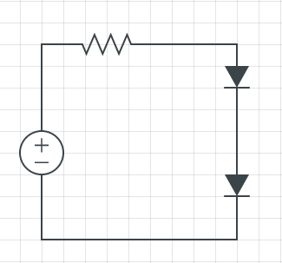
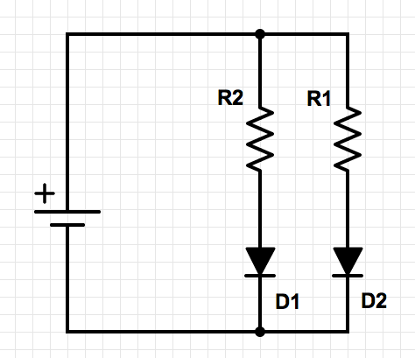
Series and Parallel
Series: in Order
Parallel: at the same time

Slide 14

Welcome to Linux

Slide 15
What Is Linux?
Linux is based on Unix, just like OS X (mac)
Hundreds of versions
At its core: Operating system

Slide 16
Terminal
pi@raspberrypi ~ $
Your username followed by @
The name of your computer
Current directory ( ~ means home)
Shell prompt. Text will appear to the right
1
2
3
4
1
2
3
4

Slide 17
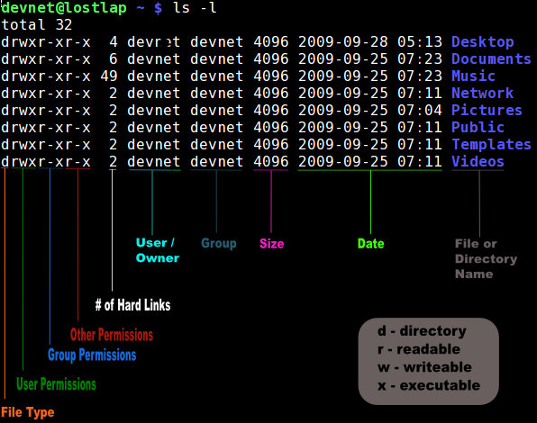
Permission

Slide 18
Commands
Too many commands to for a complete list
Common commands
cp <source> <destination>
mv <source> <destination>
cd <folder>
ls
Alias commands

Slide 19
Intro to coding
What is code?
Best to use IDE ( Integrated Development Environment )
Languages
Any language which will compile for ARMv6 can be used with the Raspberry Pi. Python, C, C++, Java, Scratch, and Ruby all come installed by default on the Raspberry Pi.

Slide 20
Coding Logic
Pseudocode
Example:
If there are eggs at the grocery store then, buy a loaf of bread, else buy milk.
All coding languages follow common coding logic

Slide 21
Variables
A way to assign values
Values vary by contents and type
Common variable types
Int (integer)
String (letters, numbers, symbols… usually for humans to read)
Boolean (true or false)

Slide 22
Simple if statement
Int temperature = 70;
Int temperature = 80;
Bool condition_met = false;
If (temperature == 70)
{
//Will we meet the if condition?
condition_met = true;
}
Else
{
condition_met = false;
}

